Slide 1
KineTrax
Team KineJax
Anthony Black, Jack Jenkins, Cherie Parsons, Grant Swanson, Christopher Whitney
Client/Mentor: Dr. Kyle Winfree
Notes:
Chris

Slide 2
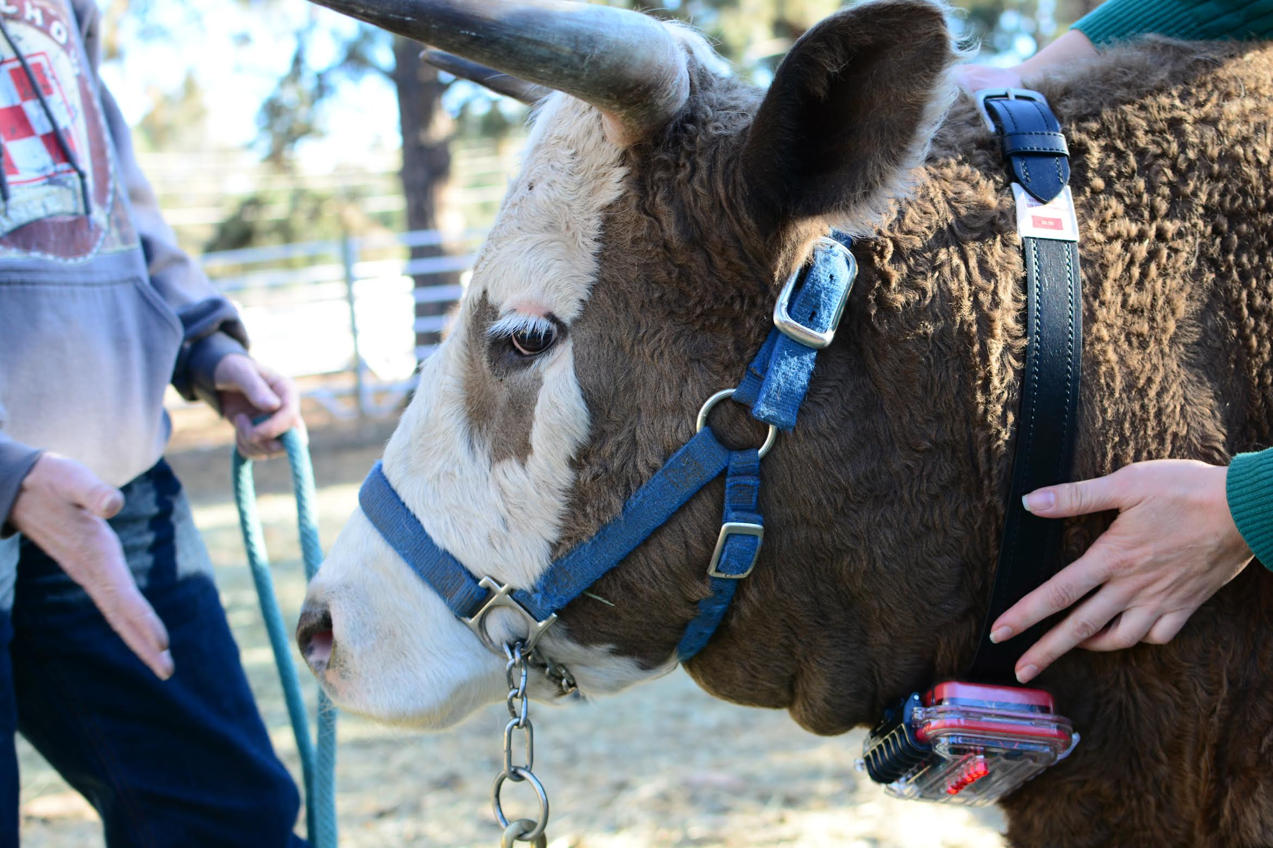
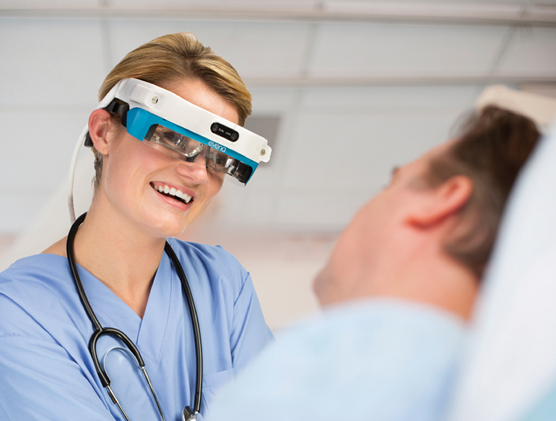
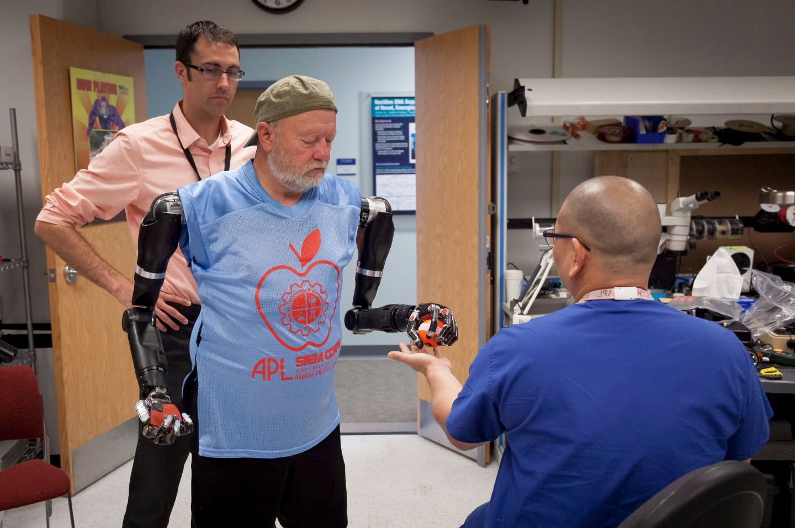
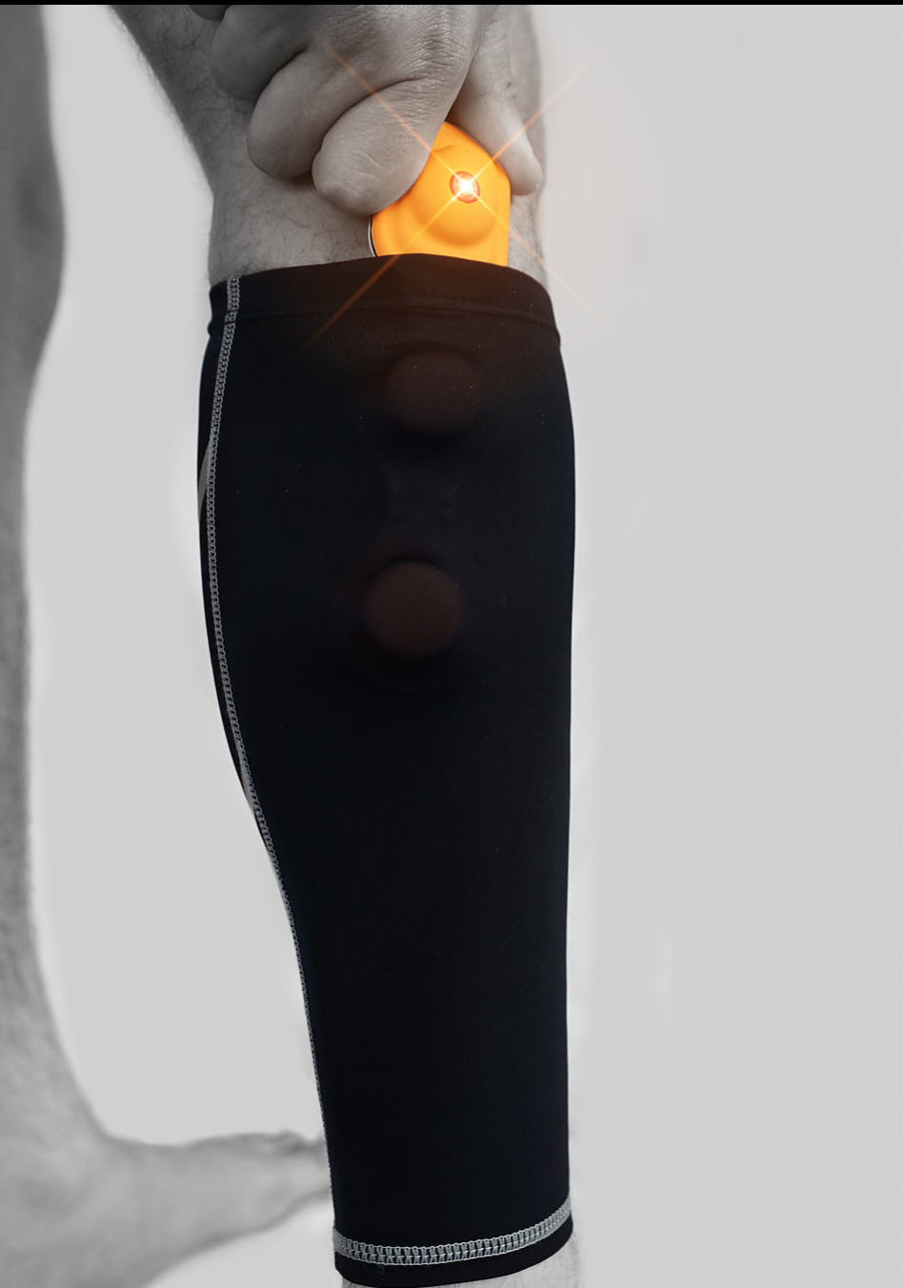
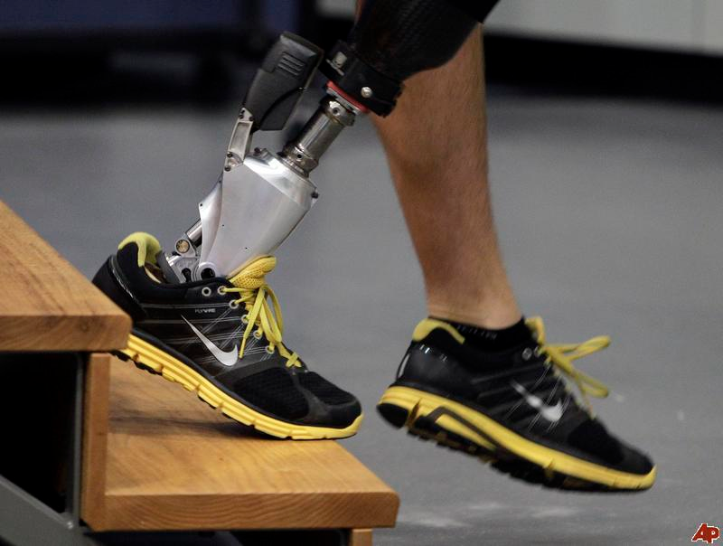
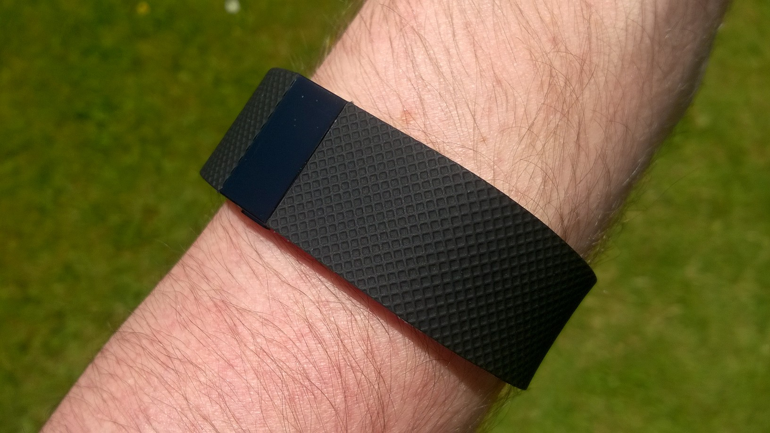
Domain Introduction
Notes:
Chris

Slide 3
Limitations of Current Technologies
Domain Problem - Current wearable devices:
Unable to interface with other devices
No synchronization across a distributed network
Doesn't yield the resolution of measurements as other capturing systems
Project Specific Problem:
There is no software framework for the device
 | Fitbit | ActiGraph | Vicon
Interface w/ devices
Sync
Resolution | 1 min | 30-100 Hz | 100+ Hz
Cost | Low | Expensive | Expensive
Notes:
Grant
put chart comparing fitbit,actigraph,vicon instead of wireless signal
compare resolution,synchronization interfacing w/ other devices

Slide 4
Problem Statement
Current wearable devices are unable to interface with other device and are unable to give the necessary resolution for gait analysis in a community setting.

Slide 5
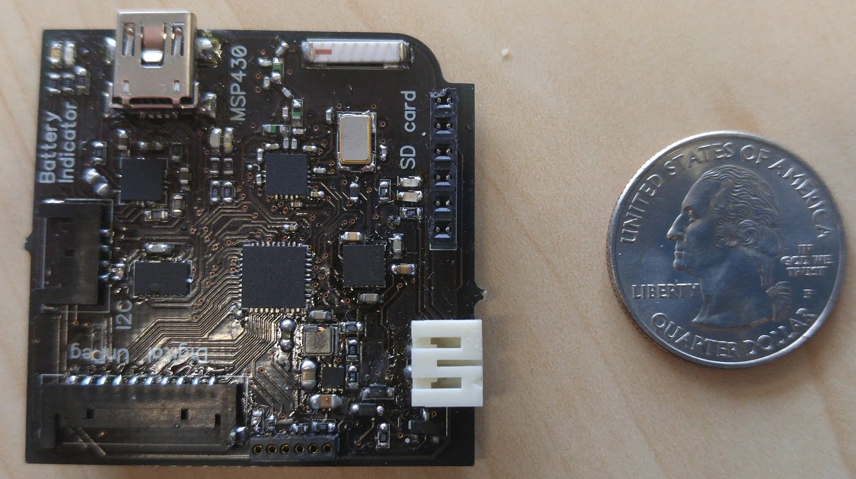
Project Introduction
KineTrax Device:
Wearable device
Records full body kinematics
  Position and rotation of limbs
Gait analysis
  Movement impairments
  Physical impairments
  Prosthetic limbs
  Sports medicine
Notes:
Grant

Slide 6
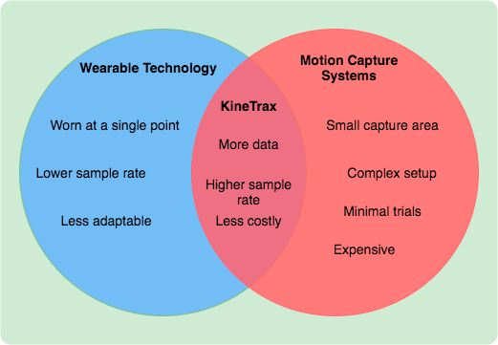
Solution Overview
What the KineTrax offers:
Digital I/O ports
Analog I/O ports
I2C bus, allowing 127 sensors/peripherals
Create software that allows:
Time synchronization between devices (Embedded)
Recording of timestamped accelerometer/gyroscope data to SD card (Embedded)
Data offloading from SD cards (Embedded/PC)
Device configuration via processing language (PC)
Notes:
Cherie
I2C allows 127 different sensors, but 2 are takes, accelerometer, rate gyro
More depending on the use of the I/O ports

Slide 7
Implementation Overview
Notes:
Chris - C and Processing

Slide 8
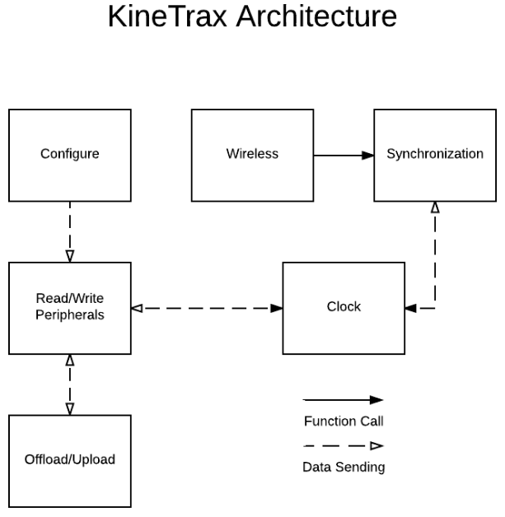
Architectural Overview(Embedded)
Peripherals
  Peripherals accessed through Inter-Integrated Circuit (I2C) and Universal Asynchronous Receiver/Transmitter (UART)
  Key functions:
    read()
    write()
Wireless Communication
  Communication with other devices via 2.4 GHz Radio Frequency
  Utilizes SimpliciTI Protocol
  Key functions:
    connect()
    getMessage()
    sendMessage()
Synchronization
  Calculates offset between time from Real Time Clock and time received from wireless messages.
Notes:
Anthony
UART
I2C implemented through the URART
SD through OpenLog Protocol
Processor - Main Loop
SimpliciTI for Network
Network via RF 2.4 GHz
RTC on I2C
Serial (putc())

Slide 9
Architectural Overview(Embedded) (cont.)
Real-time Clock
  Responsible for getting and setting time
  Communicates via I2C and UART
Configuration
  Sets peripheral addresses
  Sets peripheral sample rates
  Information assigned to variables for use
Offload/Upload
  Write configuration data to SD card from offload software
  Send data from SD card to offload software
  SD card accessed via OpenLog protocol
  Serial communication used for offload software
  Key functions:
    checkForConnection()
    sendInfo()
    getInfo()
Notes:
Anthony
UART
I2C implemented through the URART
SD through OpenLog Protocol
Processor - Main Loop
SimpliciTI for Network
Network via RF 2.4 GHz
RTC on I2C
Serial (putc())

Slide 10
Architectural Overview(PC)
Offload Data from Device
  Reading data from device
  Raw data to CSV
Configuration
  Loading from configuration file
  Saving to configuration file
  Setting configuration on device
Notes:
Anthony

Slide 11
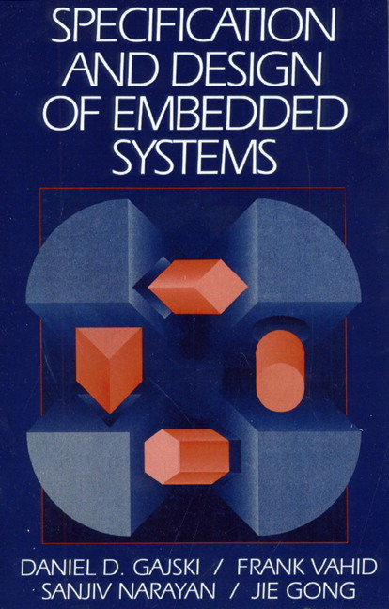

Challenges and Resolutions
Big Challenges:
Code Composer Studio(IDE)
  Debugging
    Print statements
    Break points
  Understanding the stages in the build process
Embedded Systems
  Learning curve for embedded systems
  Acronyms (RTC,I2C,SPI,etc.)
Existing Code has minimal documentation
Resolution:
Research
  Existing Documentation/Sample Code
  Texas Instruments forums
  Embedded System Books
Notes:
Jack
Debugging(CCS issues),
Print statements/debugging: We have a suspicion that the c compiler is optimizing out the lines that we use for debugging such as variables not being used.
Build process: The configuration dat files, where are things linked.
Learning curve /acronyms

Slide 12
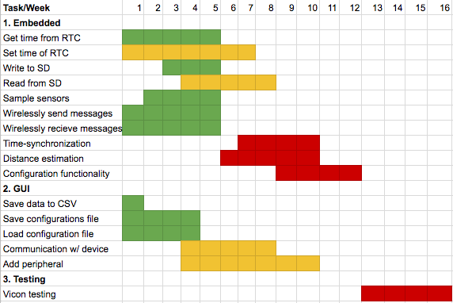
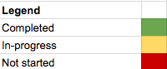
Schedule
(Spring break not included)
Notes:
Jack

Slide 13
Conclusion
KineTrax has the potential to benefit lots of areas:
Movement impairments
Prosthetic limbs
Sports medicine
Farm animals
Lots of progress has been made:
Device can sample sensors
Device can get time from RTC
Device can wirelessly communicate
GUI reads raw serial data to CSV
GUI loads configuration file
GUI can save configuration file
Notes:
Jack
So in concluson.
The KineTrax has the capability to become something bigger than helping out with just movement impairments.

Slide 14
References
http://evenamed.com/eyes-on-glasses/
http://www.fabricatingandmetalworking.com/2015/02/waterjet-used-make-prosthetic-limb/Winfree
http://www.pcclassesonline.com/fitbit-charge-hr-vs-surge-review-and-tutorial/
http://www.operationward57.org/2011/03/new-bionic-prosthetic-for-lower-leg-amputees/
http://toughasia.com/blog/wearable-tech-vylyv-labs-smart-shorts-enable-men-to-strengthen-pelvic-floor-muscles/
https://www.amazon.com/Programming-Embedded-Systems-Development-Tools/dp/0596009836
https://www.pearsonhighered.com/program/Gajski-Specification-and-Design-of-Embedded-Systems/PGM30685.html
http://www.quintic.com/education/case_studies/Gait%20Analysis.html

Slide 15
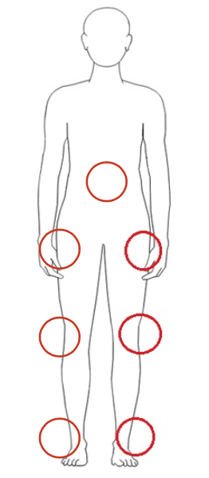
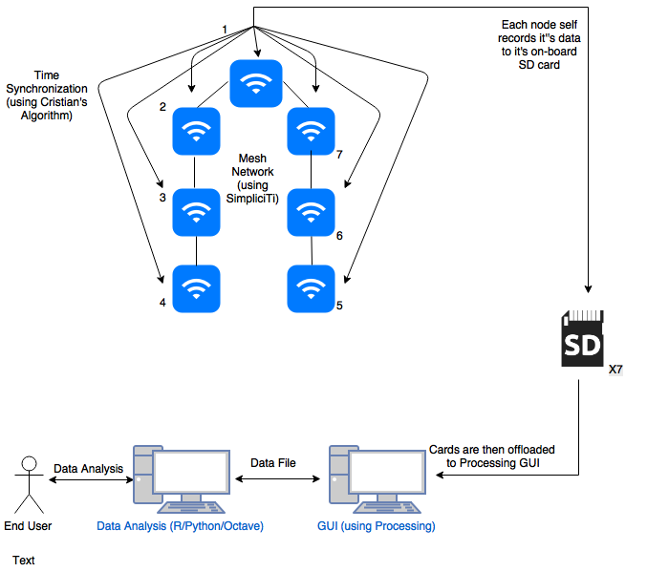

Slide 16
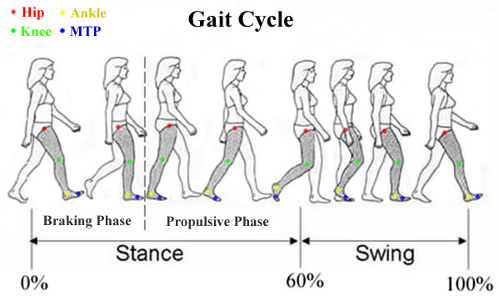

Slide 17
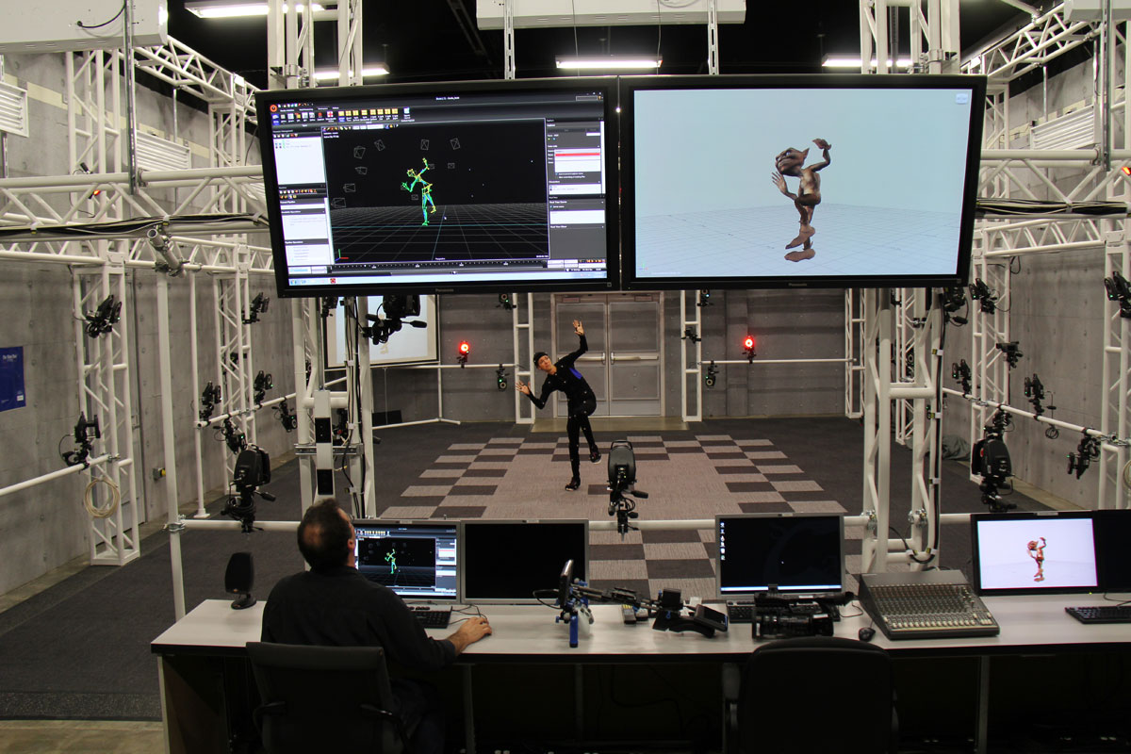

Slide 18
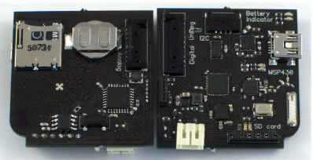
Tracks time
Records data (accelerometer) daily into 32GB (per month storage)
I2C(RTC protocol)
SD CARD
Radio antenna(communication to other KineTrax devices)
Gets data from different parts of body
MSP430 CHIP
Notes:
Less texts, more figures/data (i.e. 32GB, Month, points worn on the body, 6-axis IMU, point to radio antenna, I2C supports 125 more sensors)
What are other kinds of I2C devices? (GPS)
More applications than just person wearable (i.e. cattle)

